Slide 1
Bird Strike Analysis Data Analysis and Visualization with Python and Power BI
Presented by: Abdul Rauf

Slide 2
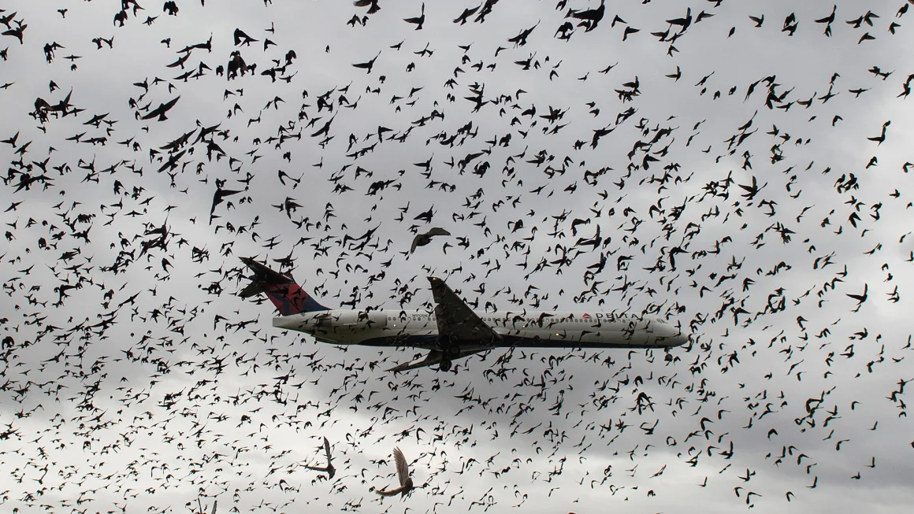

Slide 3
Table of Contents
Problem Statement
Case Studies
Data Preparation with Python
Power BI Dashboard Visualizations
Key Insights
Conclusion
Future Scope & Improvements

Slide 4
Problem Statement
Content:
Bird strikes pose significant risks to aviation safety, resulting in costly repairs and potential flight delays. This project analyzes historical bird strike data to identify high-risk conditions based on variables such as altitude, wildlife species, and flight phase. The goal is to understand patterns and suggest measures to mitigate these incidents.
Objective:
To extract actionable insights that support decision-making for reducing bird strike incidents in aviation.

Slide 5
Case Studies on Bird Strikes
Case Study: FAA Wildlife Strike Database
Content:
The FAA Wildlife Strike Database reveals that bird strikes predominantly occur during takeoff and landing, with significant financial impact on airlines and airport authorities.
For instance, one case documented an engine replacement costing around $300,000 after a large bird strike at a major U.S. airport.
Key Insight:
Bird strikes are highly dependent on location and migratory patterns, suggesting a need for location-specific preventive strategies.

Slide 6
Dataset Overview
Source:
FAA Wildlife Strike Database
Key Columns:
Record_ID, Aircraft Type, Airport Name, Altitude bin, Wildlife Species, Phase of Flight, Impact to Flight, Damage Level, Cost, Date
Sample Data:
Display a table showing a few rows from the dataset, with columns like Date, Altitude bin, Species, and Damage.

Slide 7
Data Preparation in Python
Removed rows with missing values in critical columns.
Converted Date columns to a datetime format for time-series analysis.
Created new columns, such as Altitude bin for altitude ranges and Cost Category to label incidents by severity.

Slide 8
Power BI Dashboard Overview
Content:
The dashboard provides a comprehensive view of bird strike trends, altitude impact, affected airlines, and incident costs.
Visuals:
The yearly trend of bird strikes, impact of altitude, top affected airlines and species distribution.

Slide 9
Bird Strikes Over Time
Title:
Yearly Trend of Bird Strikes
Chart Type:
Line Chart
Content:
Displays the annual trend in reported bird strikes.
Insight:
An upward trend over recent years suggests an increasing risk, possibly due to urban expansion near airports.

Slide 10
Monthly Bird Strike Distribution
Title:
Monthly Bird Strikes Distribution
Chart Type:
Column Chart
Content:
Shows bird strikes by month.
Insight:
Higher incidents during spring and fall align with bird migratory seasons.

Slide 11
Top 10 Airports with Bird Strikes
Title:
Top Airports Affected
Chart Type:
Stacked Bar Chart
Content:
Highlights the top 10 airports by bird strike frequency.
Insight:
Some airports experience higher incidents due to nearby wildlife habitats.

Slide 12
Bird Strikes by Altitude
Title:
Bird Strikes by Altitude
Chart Type:
Treemap
Content:
Categorizes bird strikes based on altitude.
Insight:
Most incidents occur at low altitudes, emphasizing the need for low-altitude preventive measures.

Slide 13
Species Involved in Bird Strikes
Title:
Species Distribution in Bird Strikes
Chart Type:
Pie Chart
Content:
Shows the distribution of bird species involved.
Insight:
Larger species like geese have a higher financial impact, reinforcing the need to focus on deterring large bird species.

Slide 14
Impact Severity by Flight Phase
Title:
Flight Phase & Severity of Bird Strikes
Chart Type:
Stacked Column Chart
Content:
Compares flight phases (e.g., takeoff, landing) against severity levels.
Insight:
Takeoff and landing are particularly high-risk phases, suggesting targeted safety protocols.

Slide 15
High vs. Low-Cost Incidents
Title:
High vs. Low-Cost Bird Strikes
Chart Type:
Donut Chart
Content:
Highlights the percentage of high-cost versus low-cost incidents.
Insight:
High-cost incidents are a small percentage but significantly impact financials.

Slide 16
Species and Cost Relationship
Title:
Cost Analysis by Bird Species
Chart Type:
Scatter Plot
Content:
Maps bird species against average cost per incident.
Insight:
Some species consistently result in higher costs, guiding targeted risk reduction for specific species

Slide 17
Key Insights
Bird strikes are frequent during migratory seasons.
Higher altitudes reduce incidents, while low altitudes are more prone to strikes.
Takeoff and landing phases have the highest risk, especially with larger bird species.
Targeted measures at specific airports can reduce incidents and associated costs.

Slide 18
Conclusion
Summary:
This analysis reveals critical patterns that can inform preventive measures.
Actionable Suggestions:
Strengthen bird control measures, especially during peak migratory months and at airports near wildlife habitats.

Slide 19
Future Scope & Improvements
Data Expansion:
Include more recent data for current insights.
Predictive Modeling:
Use machine learning to predict high-risk times or conditions.
Enhanced Visualizations:
Implement interactive features in Power BI for in-depth analysis.

